Slide 1

Mixtures and Baskerville data – what isn't there can exonerate
Looking under the analytical threshold
Charles Brenner, Ph.D.
Purveyor of forensic mathematics
DNA∙VIEW®
Senior Fellow, UC Berkeley Human Rights
charles@dna-view.com
http://dna-view.com
O-36, 482
Sep 13, 2024.Fri 9:54 - 10:06
Notes:
A recent mixture case has multiple remarkable and new points of interest.
This is the story of one of them.

Slide 2

Probabilistic mixture software is biased against the innocent.
This presentation exposes a bias in the evaluation of DNA evidence to which (nearly?) all mixture software is susceptible.
Situations in which the bias would manufacture a case against an innocent suspect are probably not rare.
A current criminal case is an example.

Slide 3
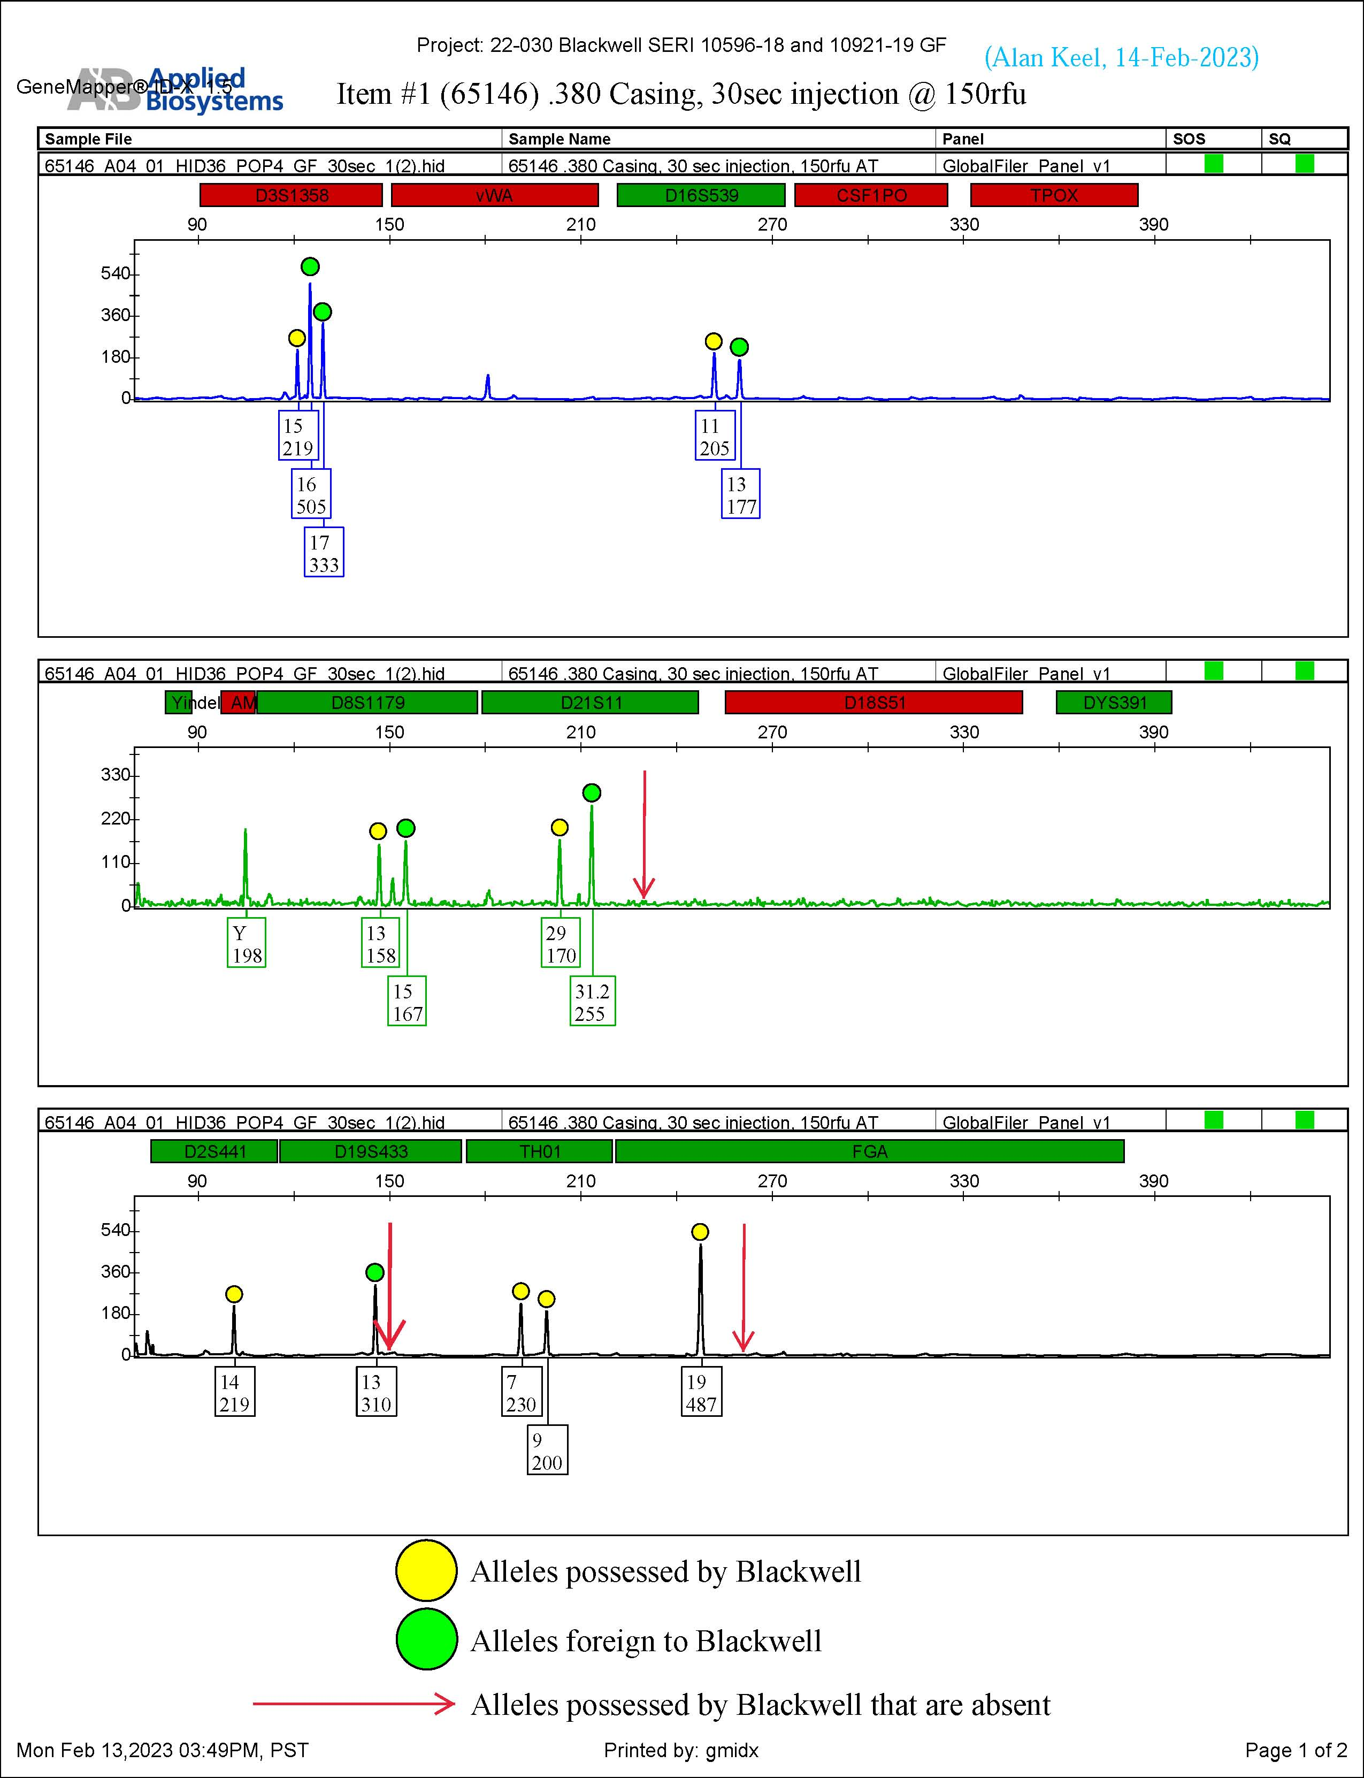
Dropout of Blackwell alleles looks plausible.
Alleles possessed by Blackwell
Alleles foreign to Blackwell
Alleles possessed by Blackwell that are absent

Slide 4

How mixture analysis can be unfair
The analytical threshold (AT=150 for example) is designed to be “conservative” – extra fair – to the suspect.
“Conservative” here means “discard sub-threshold information”.
But – more information tends to shed light and truth.
  Therefore discarding DNA information helps criminals.
  By hiding helpful evidence, it hurts innocent non-contributors.
Summary: Ignoring sub-threshold information (being “conservative”) helps the wrong guy.
Notes:
… has opposite of its intended effect.

Slide 5

Mixture and Sub-threshold
A “DNA mixture” is ultimately an epg – a graph. The graph represents physical DNA but imperfectly, incompletely, and also includes garbage.
Epg interpretation adopts an Analytical Threshold as a lower bound below which epg data is ignored as unreliable. But a subtle error:
  Sub-threshold signals may represent real DNA, but may be garbage, so are unreliable as information.
The Baskerville principle
  Lack of signal (called “Baskerville” information) isn’t susceptible to the “unreliable information” argument.
Therefore “Baskerville” sub-threshold information must be admissible.
  Effect can be computed, sometimes simply
Likely to be exculpatory.

Slide 6
Void below AT is Baskerville information
A locus
12
Genotype of suspect
14
AT=150
Sub-threshold Baskerville Void is reliable information.
  Dropout? or Suspect didn’t contribute?
  (Sometimes nothing can be a real cool hand)
(Sub-threshold signal is beyond this short talk.)
Baskerville
sub-threshold area
Traditional “don’t look”
sub-threshold area
0 rfu
allele #12
recorded
allele #14
position

Slide 7
(Example of)
expected height,
of suspect allele
Eliminating a Baskerville zone of possible allele heights reduces likelihoods
that dropout occurred, and
that suspect contributed.
14 0
120
rfu
DT=100
Baskerville zone
60
4 0
?
20
0
Suspect genotype
Notes:
Illustrating previous slide with more context (rotated 90 degrees so rfu is on vertical axis as customary, and including sister allele)

Slide 8
.
The Baskerville principle (insight #1)
  Lack of signal isn’t susceptible to the “unreliable data” argument
Consequence (insight #2)
  “Baskerville” sub-threshold information must be admissible.
  Effect can be computed (sometimes simply).
  Helps defence
For a California case just ended, the likelihood ratio moved down to close to 1.

Slide 9

Discoveries
Baskerville data: Sub-threshold but 100% reliable.
How sub-threshold information can be exculpatory.
And there are other overlooked analysis issues
  for another time

Slide 10
Logic of the role of “dropout” in evidence
Dropout: Failure of an expected allele to appear above DT.
Competing claims:
  Prosecution: Dropout happened. (Suspect contributed, although weakly.)
  Defense: Dropout didn’t happen. (Lack of dropout.)
Therefore
  the higher Pr(dropout) is
  the stronger the prosecution’s case is.

Slide 11
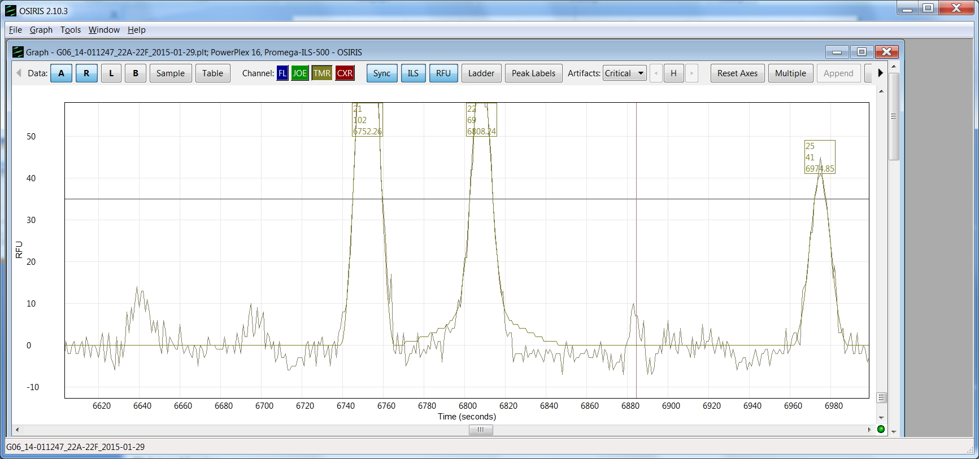
Flip side of JN sub-threshold data: FGA
bbbbb
Cold case Florida 1990
JN is 19, 21 at FGA. Hint of signal at FGA #19 position.
It’s faint: 11rfu is sub-threshold and 9x fainter than #21.
Misshapen (uncharacteristic of a real allele)
Locus FGA
of fingernail mixture
#21
102rfu
#22
69 rfu
#19
6641
#20 posn
8 rfu?
stutter?
#19 posn
11 rfu?
#20
6696
35 rfu
#25
49 rfu
0 rfu
JN?
JN

Slide 12
Evaluating sub-threshold signals
Factors influencing Pr(signal reliable)
  How high (close to DT more reliable)
  Morphology (Osiris)
  Position (+0.5 bp suspicious)
  Frequency (never-seen allele suspicious)
How to quantify? How to validate?
Notes:
Presumably TrueAllele (no threshold) implements an answer. I tend to believe there’s no correct answer. But maybe – I don’t know - that flawed evaluation of low-level data is a lesser evil than a threshold that masks it altogether.

Slide 13
Remarkable mixture case – software limitation lessons
2020 in Sonoma
#1 point: Dropout analysis is biased against the innocent.
  New “Baskerville” model of dropout
And: Stochastic variation in allele signals when touch DNA is involved:
  Lab-prepared validation samples are not representative.
  different stochastic variation for different contributors
Thought: confirmation bias depending on order of inspecting loci.
Other points another day
Notes:
Any software using data-cutoff threshold is susceptible.

Slide 14
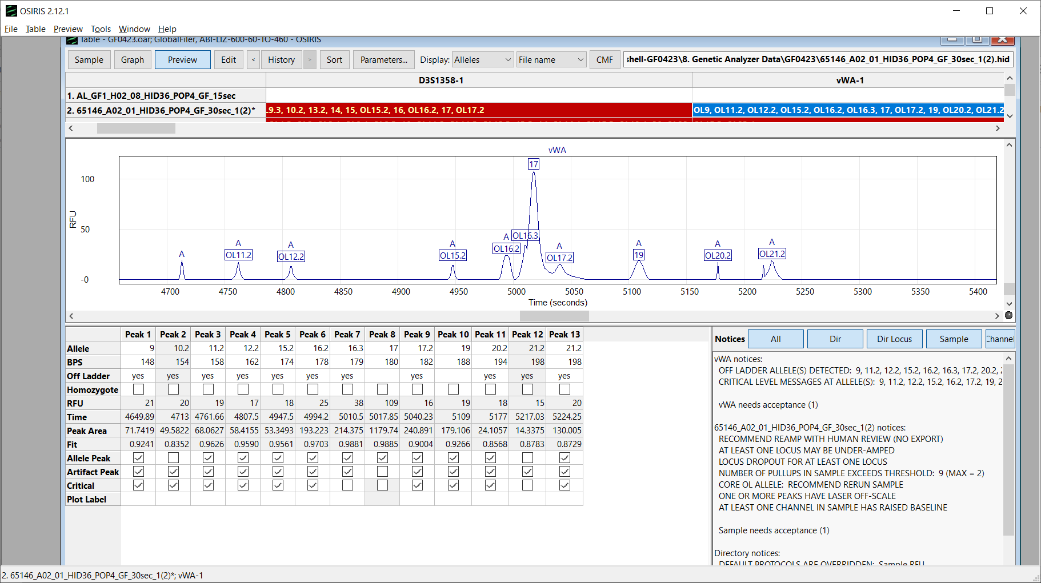
Locus vWA
#17 109rfu
Sonoma trial 2020
100
Sub-threshold
RFU
50
0
17
19
Baltimore’s genotype
Notes:
Threshold = 100rfu is lab protocol. Perhaps analyst is blinded to the sub-threshold(?).

Slide 15
Locus vWA
#17 109rfu
Sonoma trial 2020
100
Sub-threshold
RFU
#19
19rfu
Awful shape
50
#12.2 & #15.2. “Off ladder”,
Bad shape
0
Bingo. There’s both suspect alleles.
That’s not an allele, and if it is it’s not my client.
17
19
Baltimore’s genotype
What’s up?
Notes:
Let’s look. Lots of ambiguity. Is #19 Baltimore? Tempting. Osiris says bad morphology – worse than the easier-to-discard similar shapes at the left.

Slide 16
Dropout
Dropout: 0 ≤ hgt < DT, where
  hgt = observed height (rfu) of an allele signal
  DT = detection threshold = rfu below which data ignored
Pr(dropout) is computable in terms of an expected height E(hgt).
  It’s the probability a signal expected at E(hgt) is “observed” at a hgt < DT.
  i.e. at hgt=DT-1, or at hgt=DT-2, … or at hgt=1, or not at all.

Slide 17
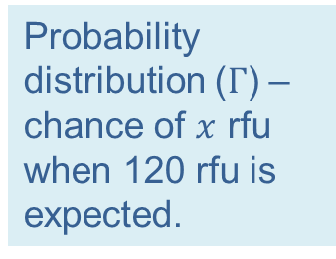
How to calculate dropout probability at one locus
Detection
threshold
by direct integration
(Mixture Solution™ way)
Probability distribution ($Γ$) – chance of $x$ rfu when 120 rfu is expected.
likelihood
Expected
height of some
unobserved
allele
0
100
120
rfu
Pr(dropout | 120rfu expected)
=0.178
=0.35
0.094=
=0.3
=0.33
0.084+
0.07+
0.051+
0.032+
0.016+
0.005+
Notes:
“Expected height” = average height over repeated experiments with specified fixed initial DNA dosage.
A full range of initial DNA dosages are considered by the software, and ultimately the results are averaged.

Slide 18
Pr(dropout); Baskerville calculation
Detection
threshold
Mixture Solution™ initial implementation
Suppose no data observed here.
Baskerville zone
Probability distribution ($Γ$) – chance of $x$ rfu when 120 rfu is expected.
likelihood
Expected
height of some
unobserved
allele
0
100
120
rfu
0.032=
Pr(dropout | 120rfu expected)
=0.06
0.016+
0.005+

Slide 19
(Example of)
expected height,
of suspect allele
Eliminating a Baskerville zone of possible allele heights reduces likelihoods
that dropout occurred, and
that suspect contributed.
14 0
120
rfu
DT=100
Baskerville zone
60
4 0
?
20
0
Suspect genotype
Notes:
Illustrating previous slide with more context (rotated 90 degrees so rfu is on vertical axis as customary, and including sister allele)

Slide 20
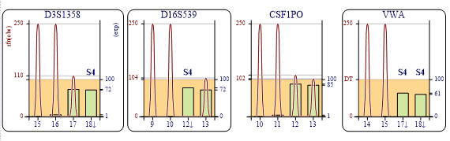
Baskerville patterns – happy & sad
concocted
At protocol DT of 100rfu
  50% of S4 genotype
Can go either way.
262R
S4 genotype
Dropout (assuming S4 contributed)
Legend
Notes:
Example mixture with filtering at 100rfu threshold

Slide 21
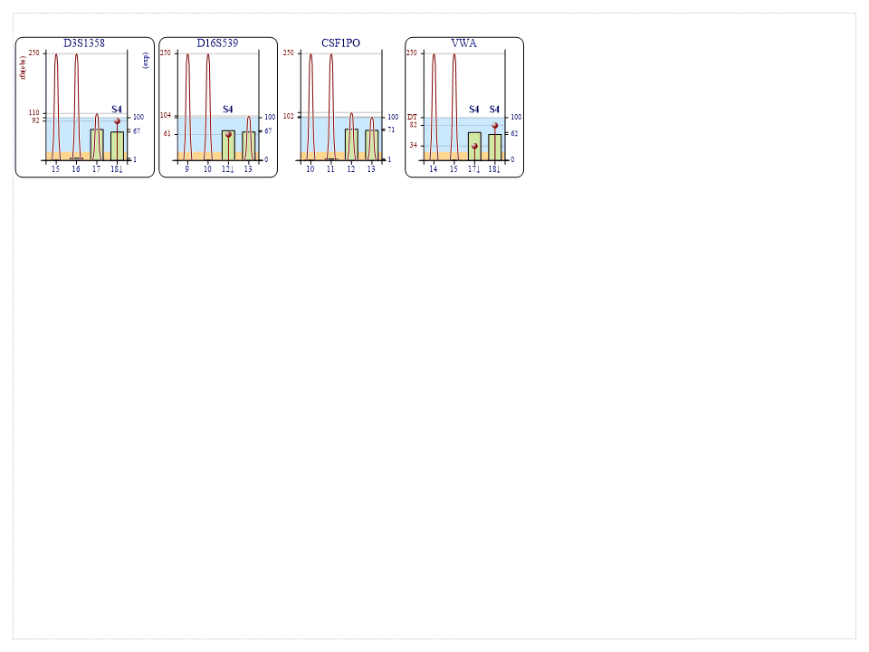
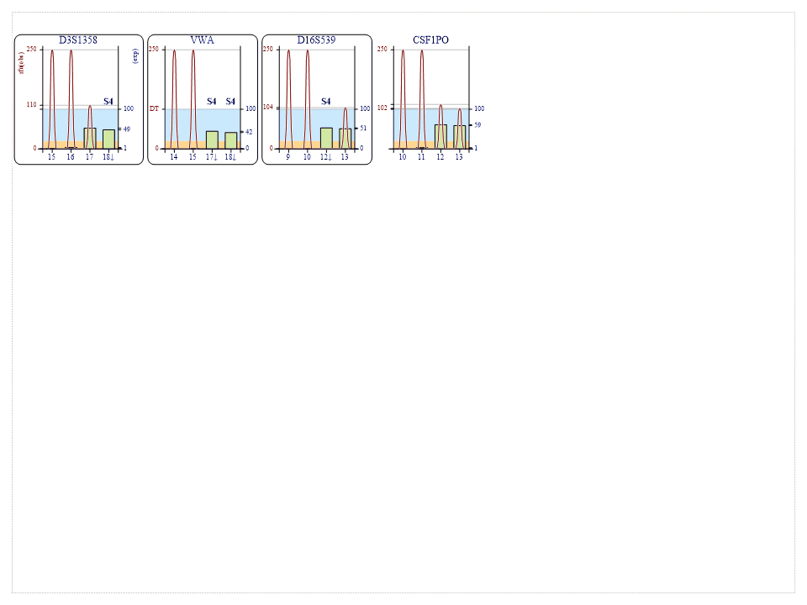
Baskerville patterns – happy & sad
concocted
At protocol DT of 100rfu
  50% of S4 genotype
Can go either way.
262R
Baskerville zone 100(20)
  100% of S4 genotype
Bad omen for S4.
262R
Baskerville zone 100(20)
  50% of S4 missing
Lucky dog S4.
262R0 100(20) 13.450h
Notes:
Two possible sub-threshold stories. #2 is common and supports prosecution expectation. #3 is exceptional, exoneration case, pay-dirt, to watch for & be ready for.

Slide 22
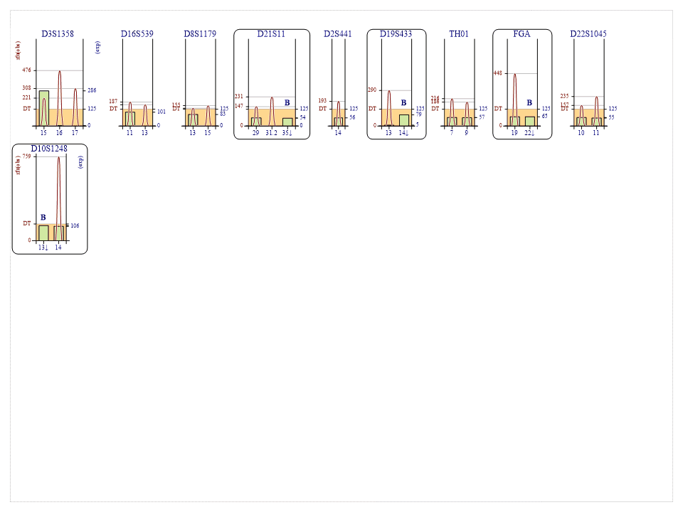
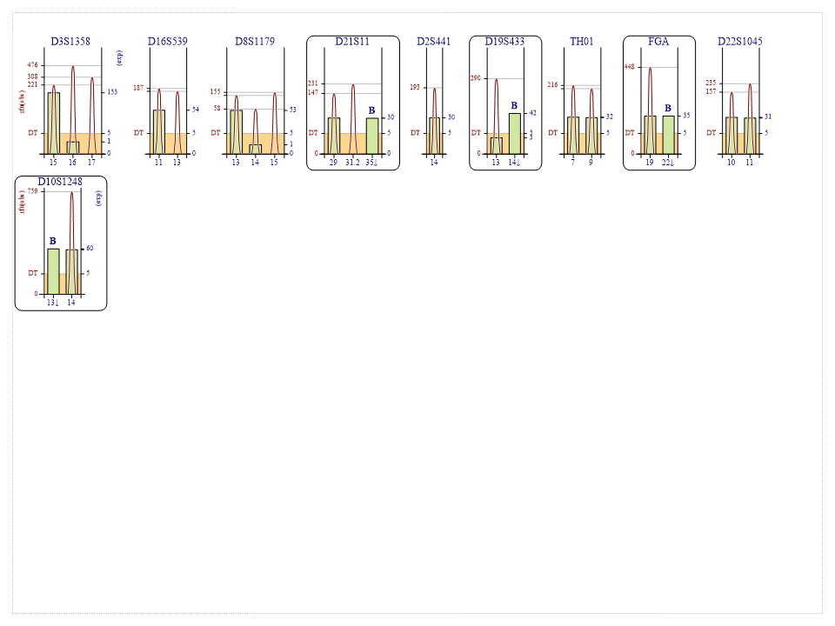
B contributed or not?
Detection Threshold = 125rfu
LR=32 – inculpatory
1801662 A2 Z8 DT125 B () LRs 2022-2-21 16.661h(epg).gif
Dropout (if B)
B genotype
Sonoma trial 2020
LR=1/6– exculpatory
Detection Threshold = 5rfu
1801662 A2 Z8 DT5 B () LRs 2022-2-21 16.668h(epg).gif
Notes:
Watch & be ready – here is the real case! All B dropouts remain B dropouts at 5rfu.

Slide 23
Diagnosis (& fixing)
Evidence under the hood (below detection threshold)
  Supports dropout (i.e. prosecution) when:
    Fits suspect genotype
    Tall and good-looking
  Exculpatory when:
    No spike at suspect allele position
    Very low (=faint) spike
    Short and/or ugly
Correcting the LR computation to account for Baskerville adjustment may be complicated.
  But a revised LR upper limit is not hard.

Slide 24
“a revised upper limit is possible”
Sub-threshold signals in positions of suspect alleles: calculate as if real allelic signals.
  Difficulty: Even signals so small, like 1rfu, that they look like instrument static?
Other sub-threshold signals: ignore as usual
The effect is to bias toward the prosecution by treating ambiguous data
  Which may or may not be real alleles
  Which if real alleles benefits the prosecution
  As if definitely real.

Slide 25
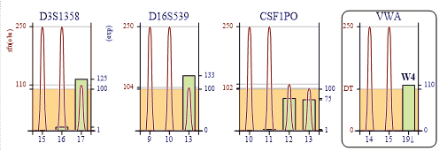
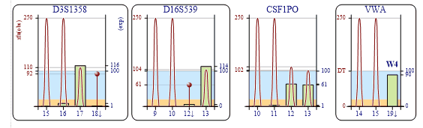
Non-contributor EPGs
concocted
Curtain 262 R W4 DT100 e0.8 Z8
2022-2-21 10.776h(epg).gif
Curtain 262 R W4 DT100(20) e1.1 Z8 2022-2-21 10.777h(epg).gif

Slide 26

Dropout calculation
Pr(dropout) = probability a signal expected at E(ht) is “observed” at some ht < DT,
  i.e. ht=DT-1, or ht=DT-2, … or ht=1, or no ht at all;
  i.e. Pr(dropout) = $Σ_{ht=1}^{DT−1}\operatorname{Pr}\left(observe ht \right| E(ht))$

Slide 27
36 point
Main point 28 point
  Subsidiary 24 point

Slide 28
